Slide 1
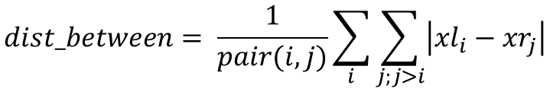
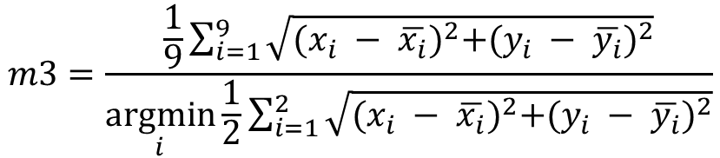

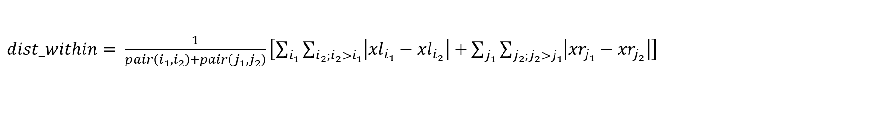
$$m1=[\max\left(x_{i}\right)−\min\left(x_{i}\right)]/[\max\left(y_{i}\right)−\min\left(y_{i}\right)]$$
$$dist_between= \frac{1}{pair(i,j)}\sum_{i}{\sum_{j;j>i}{\left|{xl}_{i}−{xr}_{j}\right|}}$$
$dist_within= \frac{1}{pair\left(i_{1},i_{2}\right)+pair\left(j_{1},j_{2}\right)}\left[\sum_{i_{1}}{\sum_{i_{2};i_{2}>i_{1}}{\left|{xl}_{i_{1}}−{xl}_{i_{2}}\right|}}+\sum_{j_{1}}{\sum_{j_{2};j_{2}>j_{1}}{\left|{xr}_{j_{1}}−{xr}_{j_{2}}\right|}}\right]$
$$m2=dist_between/dist_within$$
$$m3=\frac{\frac{1}{9}\sum_{i=1}^{9}{\sqrt{{(x_{i} − \overline{x_{i}})}^{2}+{(y_{i} − \overline{y_{i}})}^{2}}}}{\underset{i}{argmin}{\frac{1}{2}\sum_{i=1}^{2}{\sqrt{{(x_{i} − \overline{x_{i}})}^{2}+{(y_{i} − \overline{y_{i}})}^{2}}}}}$$

Slide 2
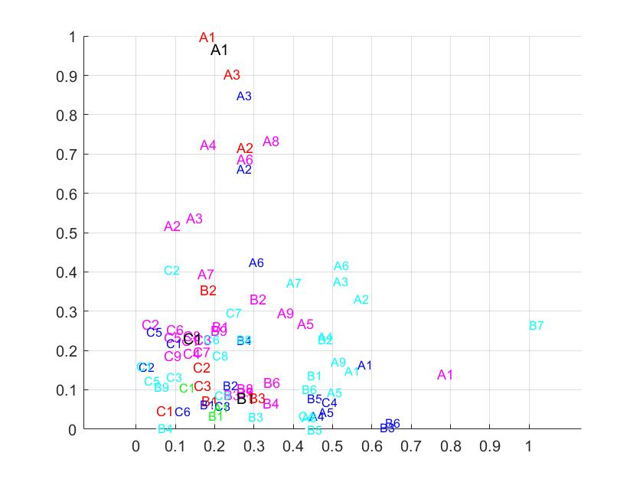
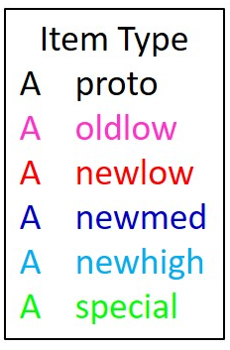
Horizontal Splitness
Width-to-height ratio
Notes:
Dim1 vs. dim 2

Slide 3
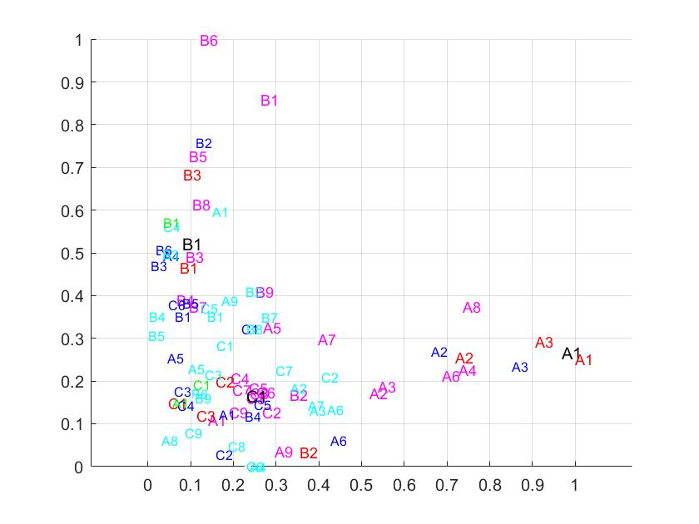
Dual Centrality
Horizontal Splitness
Notes:
Dim 2 vs. dim 3

